Slide 1



Movie Recommendation System (AI)
Model Making Team

Slide 2
MEMBERS
01
02
03
04
Aashir Shehzad
System Designer
Fayaz Noor
Preprocessing
Kashif Khan
Model Training
Saad Khan
System testing

Slide 3


01
SYSTEM DESIGNING
Aashir Shehzad

Slide 4
What is System Designing?

Slide 5
Why it is important?
Clarity and Understanding
Maintainability
Customer Satisfaction
Efficiency

Slide 6
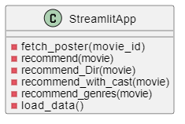
Designs
Class Diagram:

Slide 7
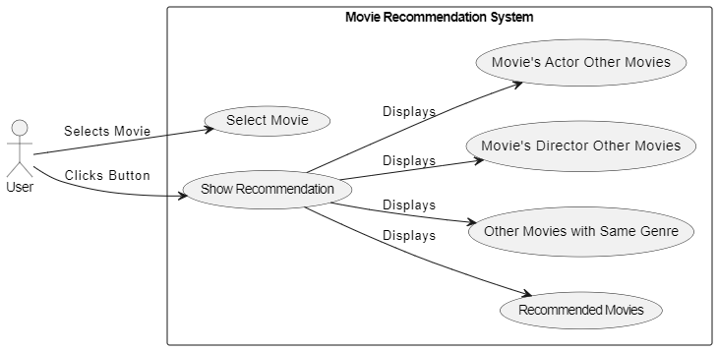
Use Case Diagram:

Slide 8
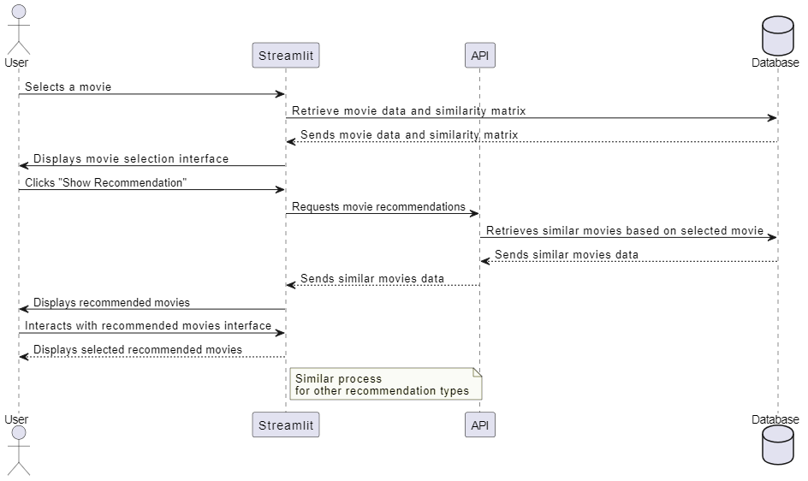
Sequence Diagram:

Slide 9
02
Preprocessing
Fayaz Noor

Slide 10
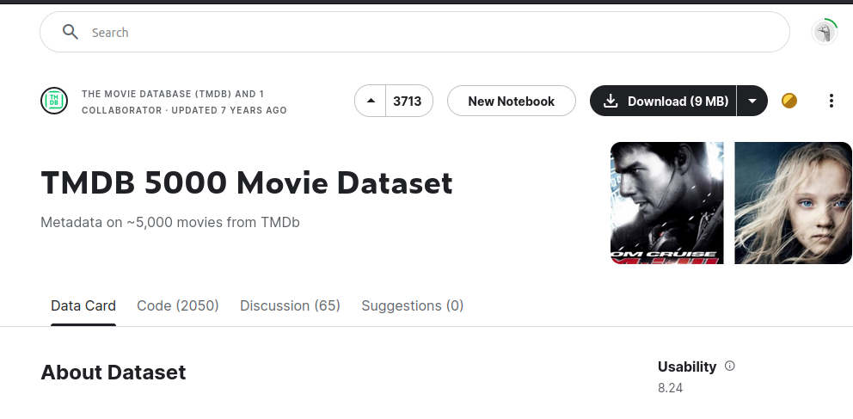
Data
TMDB 5000 Movie Dataset - Kaggle

Slide 11
Data Handling
Pandas
Numpy

Slide 12

Pandas
Used for data manipulation and analysis
It provides data structures like DataFrame and Series
Tasks:
Data cleaning
Data Transformation
Data Exploration
Functionalities:
Handling missing data
Reshaping datasets
Merging datasets

Slide 13
Numpy
Package for numerical computing
It provides support for large, multi-dimensional arrays and matrices
Tasks:
Linear algebra
Fourier analysis
Random number generation

Slide 14
Data Integration
Combining data
Two Files:
Movies ( 20 Columns )
Credits ( 4 Columns )
Merging on the basis of Title
Now Total 23 Columns

Slide 15
Feature Selection
Selecting Main Features which are useful for recommendation system
Columns:
Movie_id
Title
Overview
Genres
Keywords
Cast
Crew

Slide 16
Data Cleaning
Handling missing
3 Rows Found
Deleting Missing Values

Slide 17
Data Transformation
Converting Columns into simple representation using ast library.
Columns:
Genres
Keywords
Cast
Crew
Splitting different words into list of Overview column.
At last removing spaces from above columns.

Slide 18
Feature Engineering
Creating new features from existing ones.
Combine all features
Genres
Keywords
Cast
Crew
Overview
Into a single feature called tags.

Slide 19
Data is Ready!!!

Slide 20


Slide 21
03
MODEL TRAINING
Kashif Khan

Slide 22
Vectorization
for
Movie Recommendations

Slide 23
Vectorization: Transforming Words into Numbers
CountVectorizer.
Each word becomes a dimension in the vector.
Its frequency determines its weight.
This allows computers to understand.
Compare movies in a mathematical way.

Slide 24
Finding Similar Movies: The Power of Cosine Similarity
Need a way to compare them and find similar ones
Cosine similarity
It calculates the angle between two vectors.
A smaller angle indicates movies with similar themes and styles.

Slide 25
Why Cosine Similarity?
Euclidean distance, another measure, considers the vector's magnitude (length).
Cosine similarity focuses on the direction (angle) between movie vectors.
In movie recommendations, content (theme, style) matters more than word count.
Cosine similarity effectively recommends similar movies regardless of variations in word frequency.

Slide 26
Movie Matchmaking
We compare a user's favorite movie (or a set of movies) to all other movies in our database.
Movies with the highest cosine similarity scores are recommended.
These recommendations suggest movies you might enjoy based on your taste.

Slide 27
Lights, Camera, Recommend!!

Slide 28
04
SYSTEM TESTING
Saad Khan

Slide 29
What is System Testing?
Testing the entire Application
Validation
Activities:
Functional Testing
Non-Functional Testing

Slide 30
Testing Process Overview
Phases of Testing
Importance

Slide 31
Testing Techniques
Static Testing
Dynamic Testing

Slide 32
Program Testing
Recommendation Functionality
User Interface

Slide 33
THANKS!
DO YOU HAVE ANY QUESTIONS?
p229005@pwr.nu.edu.pk
+92 317 2358854
ittihad.com

